Slide 1

Routing , Redux
Lesson 06
Notes:
Add instructor notes here.

Slide 2
Lesson Objectives
At the end of this module on React fundamentals you will be able to:
Explain and demonstrate
URL
React Router's core components
React Routing
React Router v4
Notes:
Add instructor notes here.

Slide 3
What’s in a URL :
A URL is a reference to a web resource
Are building blocks for creating SPA’s.
Single-page applications (SPAs) are web apps that load once and then dynamically update elements on the page using JavaScript. Every React app we've built so far has been a type of SPA.
There are many routing libraries for React, and best of it is React Router. React Router gives us a good foundation for building rich application which has views and urls
routing involves two functionality:
Modifying the location of the app (the URL)
(2) determining what React components to render at a given location.
Notes:
Browser makes a request to the server for this page.
The server doesn't care about the pathname. Instead, it just returns a standard index.html that includes the React app and any static assets.
The React app mounts.
The React app extracts the identifiers from the URL and uses these identifiers to make an API call to fetch the data for the artist and the album. It might make this call to the same server.
The React app renders the page using data it received from the API call.
Each <Route>will render its respective component when its path matches the URL. Only one of these three components will be rendered into the at any given time. With this strategy, we mount the router to the DOM once, then the router swap components in and out with route changes.
Route Matching:
<Route path="users/:userId" component={UserProfile} />
The above route will match when the user visits any path that starts with users/ and has any value afterwards. It will match /users/1, /users/143, or even /users/abd(which you'll need to be validated on our own).
Add instructor notes here.
var React = require('react');
var ReactDOM = require('react-dom');
var ReactRouter = require('react-router'); // require react-router module
var Router = ReactRouter.Router; // Get Router Reference
var Route = ReactRouter.Route; //Get Route Reference
ReactDOM.render((
<Router>
<Route path="/" component={Home} />
<Route path="/about" component={AboutUs} />
<Route path="/contact" component={ContactUs} />
</Router>
), document.getElementById('app'));

Slide 4
React Router's core components
There are three types of components in React Router
1. Router components
2. Route matching components
3. Navigation components.
All of the components that you use in a web application should be imported from react-router-dom.
import { BrowserRouter, Route, Link } from 'react-router-dom‘
React-Routing
A routing library is a key component of any complex, single-page application.
React Router isn’t the only viable solution in the React/Redux ecosystem, its growing and there are many in the system.
React-Redux package allows us to wrap up a component with a container that provides access to the dispatcher and store and , keep the wrapped component synchronized with store mutations.
Notes:
Browser makes a request to the server for this page.
The server doesn't care about the pathname. Instead, it just returns a standard index.html that includes the React app and any static assets.
The React app mounts.
The React app extracts the identifiers from the URL and uses these identifiers to make an API call to fetch the data for the artist and the album. It might make this call to the same server.
The React app renders the page using data it received from the API call.
Each <Route>will render its respective component when its path matches the URL. Only one of these three components will be rendered into the at any given time. With this strategy, we mount the router to the DOM once, then the router swap components in and out with route changes.
Route Matching:
<Route path="users/:userId" component={UserProfile} />
The above route will match when the user visits any path that starts with users/ and has any value afterwards. It will match /users/1, /users/143, or even /users/abd(which you'll need to be validated on our own).
Add instructor notes here.
var React = require('react');
var ReactDOM = require('react-dom');
var ReactRouter = require('react-router'); // require react-router module
var Router = ReactRouter.Router; // Get Router Reference
var Route = ReactRouter.Route; //Get Route Reference
ReactDOM.render((
<Router>
<Route path="/" component={Home} />
<Route path="/about" component={AboutUs} />
<Route path="/contact" component={ContactUs} />
</Router>
), document.getElementById('app'));

Slide 5
React-Routing
React isn't a framework, it's a library. Therefore, it doesn't solve all an application's needs.
To create complex SPA (single page application) task like routing requires supporting cast.
React router is one among the front-end router which uses JSX Syntax.
To install this module : npm install react-router
React router uses <Router> and <Route> components to perform routing.
Like other components <Router> and <Route> does not create DOM, it just defines the rules about how application needs to work based on routes.
ReactDOM.render(( <Router>
//<Route> Renders Home component while vising the path /
<Route path="/" component={Home} />
</Router> ), document.getElementById('app'));
Notes:
Routing is the process of keeping the browser URL in sync with what’s being rendered on the page
React is a popular library for creating single-page applications (SPAs) that are rendered on the client side. An SPA might have multiple views (pages).
and unlike the conventional multi-page apps, navigating through these views shouldn’t result in the entire page being reloaded. Instead, we want the views to be rendered inline within the current page.
Each <Route>will render its respective component when its path matches the URL. Only one of these three components will be rendered into the at any given time. With this strategy, we mount the router to the DOM once, then the router swap components in and out with route changes.
Route Matching:
<Route path="users/:userId" component={UserProfile} />
The above route will match when the user visits any path that starts with users/ and has any value afterwards. It will match /users/1, /users/143, or even /users/abd(which you'll need to be validated on our own).
Add instructor notes here.
var React = require('react');
var ReactDOM = require('react-dom');
var ReactRouter = require('react-router'); // require react-router module
var Router = ReactRouter.Router; // Get Router Reference
var Route = ReactRouter.Route; //Get Route Reference
ReactDOM.render((
<Router>
<Route path="/" component={Home} />
<Route path="/about" component={AboutUs} />
<Route path="/contact" component={ContactUs} />
</Router>
), document.getElementById('app'));

Slide 6
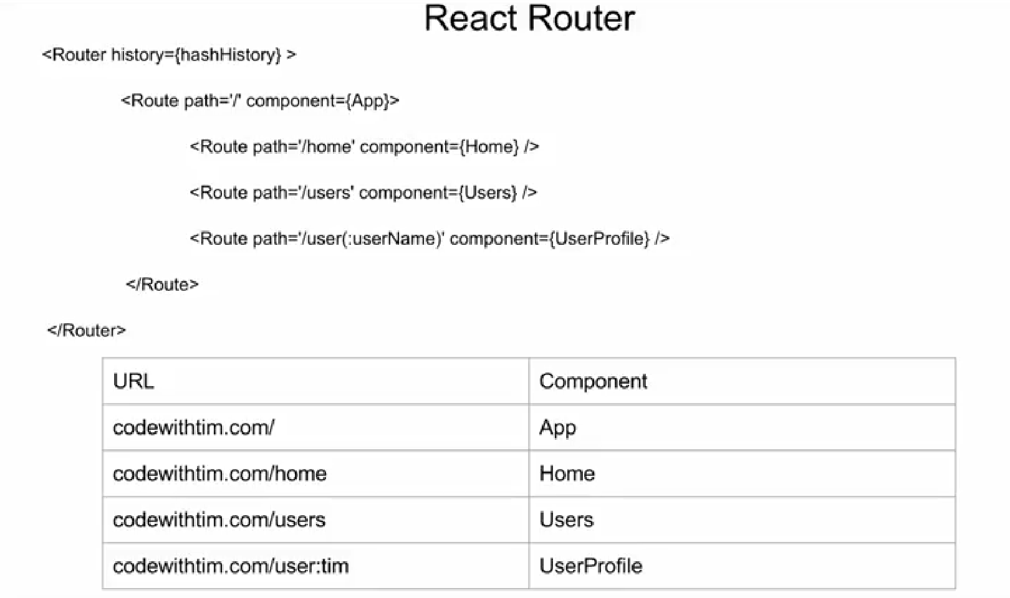
React history, path data

Slide 7
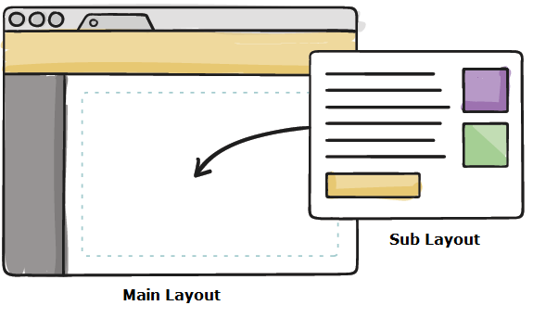
Re-Usable layout
In the diagram Sub Layout is placed inside its Parent Main Layout.
Main Layout will use this.props.children to determine Sub Layout location.
All components have this.props.children as a prop, which gets filled only when if it is a parent component nested with child components.
If the component is not a parent component this.props.children will be null.
Components will be nested in accordance with how the router nests its router.
When creating anchors for routes, use <Link to="" > instead of <a href="">
Notes:
Note : React Router recommends a wildcard router on the server-side. With this strategy, no matter what server-side route is called, the server should always serve the same HTML file. Then if the user starts directly at , even though the same HTML file is returned, React Router is smart enough to load the correct component.
Add instructor notes here.
<Router >
<Route path="/" component={App}>
<IndexRoute component={Index}/>
<Route path="about" component={About}/>
//Any other path other than specified show Error Page
<Route path="*" component={Error}/>
</Route>
</Router>, document.getElementById('app'));
var App = React.createClass({
render:function(){
return (
<div>
<Header/>
//this.props.children can be filled by Component Index, About, Error
<div> {this.props.children} </div>
</div>
);
}
});

Slide 8
React Router v4
The latest version of React Router, v4, is a major shift from its predecessors.
With React router v4, routing is not centralized anymore instead it becomes a part of the rest of the app layout and UI.
Browser specific routing components live in react-router-dom instead of react-router so imports need to be changed to be from react-router-dom package
Introducing new components such as BrowserRouter and HashRouter for specific use cases
No more use of {props.children} for nesting components in v4 React Router.
React Router v3 routing rules were exclusive meaning only one route will be matched at one time. For v4, routing rules are inclusive meaning multiple routes can be matched and then rendered.
React Router v4 was divided into three packages:
react-router: common core components between dom and native versions.
react-router-dom: the dom version designed for browsers or web apps.
react-router-native: the native version designed for react-native mobile apps.
Notes:
When we go for program ensure we install npm i react-router-dom –save through command prompt
Each <Route>will render its respective component when its path matches the URL. Only one of these three components will be rendered into the at any given time. With this strategy, we mount the router to the DOM once, then the router swap components in and out with route changes.
Route Matching:
<Route path="users/:userId" component={UserProfile} />
The above route will match when the user visits any path that starts with users/ and has any value afterwards. It will match /users/1, /users/143, or even /users/abd(which you'll need to be validated on our own).
Add instructor notes here.
var React = require('react');
var ReactDOM = require('react-dom');
var ReactRouter = require('react-router'); // require react-router module
var Router = ReactRouter.Router; // Get Router Reference
var Route = ReactRouter.Route; //Get Route Reference
ReactDOM.render((
<Router>
<Route path="/" component={Home} />
<Route path="/about" component={AboutUs} />
<Route path="/contact" component={ContactUs} />
</Router>
), document.getElementById('app'));

Slide 9
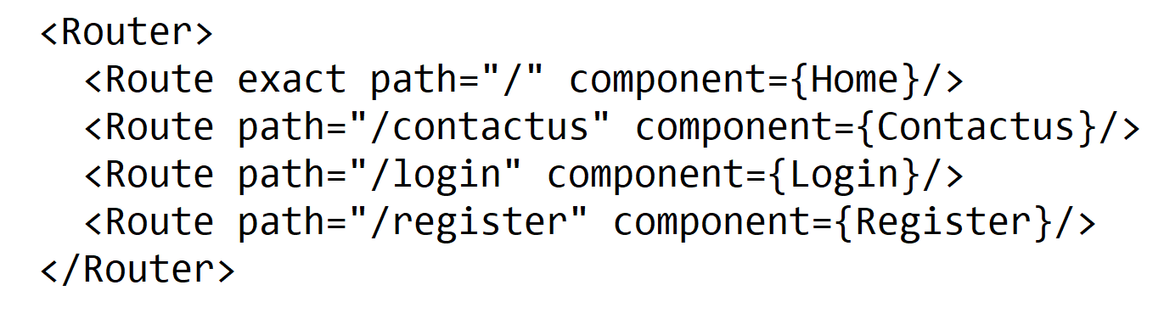
Building the components of react-router
Building a react router firstly we have to import Route and Router from ‘react-router’ library
import {Router, Route} from 'react-router';
Then add the below code snippet to render method of react Component
The path attribute defines the route URL and component attribute defines the component for this route.
Notes:
This kind of routing is different from other frameworks. Routes are also treated the same way components are treated.
Routes are first class components.
We'll take our App component and define all of the different routes we can make in our app in this App component. We'll need to pull some components from the react-router package. These components we'll use to set up this structure are as follows:
<BrowserRouter /> / <Router />

Slide 10
Navigating with react Route:
Component are used to define the root
<BrowserRouter>
<Router>
<BrowserRouter /> component is the component where React will replace it's children on a per-route basis.
<Route /> component to create a route available at a specific location available at a url.
(The <Route /> component is mounted at page URLs that match a particular route set up in the route's configuration props.)
To define a route, we'll use the <Route /> component export from react-router and pass it a few props:
path - The path for the route to be active
component - The component that defines the view of the route
The <Link /> component requires a prop called to to point to the client-side route where we want to render.
The <Switch /> component will only render the first matching route it finds.
Notes:
<Route /> component to create a route available at a specific location available at a url. The <Route /> component is mounted at page URLs that match a particular route set up in the route's configuration props.
Previously for client-side navigation we used # (hash) mark to denote the application endpoint.
In <Route /> pass exact= {true} props to the router with path='/':
If you want a route to be rendered only if the paths are exactly the same, you should use the exact props.
const Home = () => (<div><h1>Welcome home</h1><Link to='/about'>Go to about</Link></div>)
const About = () => (<div><h1>About</h1><Link to='/'>Go home</Link></div>)
In our view we'll need to add a link (or an anchor tag -- <a />) to enable our users to travel freely between the two different routes. However, using the <a /> tag will tell the browser to treat the route like it's a server-side route. Instead, we'll need to use a different component called: <Link />.
The <Link /> component requires a prop called to to point to the client-side route where we want to render. Let's update our Home and About components to use the Link:
If any error thrown in code when using Link , import Link from react-router-dom.
React router 4.x introduced some breaking changes, you'll need to import Link from react-router-dom:
After adding up above code snippet … both routes to show up after clicking on link “go to about”, it displays Info in about component on same page.
This happens because the react router will render all content that matches the path (unless otherwise specified). For this case, react router supplies us with the Switch component.
The <Switch /> component will only render the first matching route it finds. Let's update our component to use the Switch component. As react router will try to render both components, we'll need to specify that we only want an exact match on the root component.
If any error thrown in code when using Switch , import Switch from react-router-dom.
React router 4.x introduced some breaking changes, you'll need to import Switch from react-router-dom:
Advanced :
Routing with render prop:
The most powerful method of using a prop is called render. The render prop is expected to be a function that will be called with the match object along with the location and route configuration.
The render prop allows us to render whatever we want in a subroute, which includes rendering other routes

Slide 11
Demo
React Router
react-create-route
react-create-route-with-props
Notes:
Add the notes here.
Add instructor notes here.

Slide 12
Redux
Redux is a state management library
Redux lets us connect directly to application state from any part of your app.
It also allows you manipulate application state from anywhere in your app. For above statement to work properly , Redux requires that your app should have a single data store.
To set up Redux inside of our app :
Define reducers
Create a store
Create action creators
Tie the store to our React views
Profit
For adding redux to application :
Write a root reducer
Write actionCreators
Configure the store with the rootReducer, the store, and the app
Connect the views to the actionCreators
Notes:
Routing is the process of keeping the browser URL in sync with what’s being rendered on the page
React is a popular library for creating single-page applications (SPAs) that are rendered on the client side. An SPA might have multiple views (pages).
and unlike the conventional multi-page apps, navigating through these views shouldn’t result in the entire page being reloaded. Instead, we want the views to be rendered inline within the current page.
After creating a similar app we did for routing, create one then we have to add redux to the app.
For adding redux to application :
Write a root reducer
Write actionCreators
Configure the store with the rootReducer, the store, and the app
Connect the views to the actionCreators
// Initial (starting) state const initialState = { currentTime: new Date().toString() }
// Our root reducer starts with the initial state
// and must return a representation of the next state
const rootReducer = (state = initialState, action) => { return state; } export default rootReducer
Each <Route>will render its respective component when its path matches the URL. Only one of these three components will be rendered into the at any given time. With this strategy, we mount the router to the DOM once, then the router swap components in and out with route changes.
Route Matching:
<Route path="users/:userId" component={UserProfile} />
The above route will match when the user visits any path that starts with users/ and has any value afterwards. It will match /users/1, /users/143, or even /users/abd(which you'll need to be validated on our own).
Add instructor notes here.
var React = require('react');
var ReactDOM = require('react-dom');
var ReactRouter = require('react-router'); // require react-router module
var Router = ReactRouter.Router; // Get Router Reference
var Route = ReactRouter.Route; //Get Route Reference
ReactDOM.render((
<Router>
<Route path="/" component={Home} />
<Route path="/about" component={AboutUs} />
<Route path="/contact" component={ContactUs} />
</Router>
), document.getElementById('app'));

Slide 13
Redux has following Components:
Actions
Reducers
Store
Data Flow
Actions
Sends data to
triggers
Reducers
View / Browser
defines
updates
holds
Store
State
Notes:
Use Create-react-app to create application / copy paste the node_modules and packages.json into new folder
Then npm i --save redux and then npm install --save react-redux so that we can use the functionality of redux
const initialState = { currentTime: new Date().toString() }
const myReducer = (state = initialState, action) => { return state; }
In the function, we're defining 2 arguments, 1st is initialState and second is action;
The first time it runs, the myReducer is called with no arguments, so it will always return the initialState.
The second argument here is the action that gets dispatched from the store.
Any action must include a type key. The type key can be any value we want and its mandatory.
The react-redux package exports a component called Provider. The Provider component makes the store available to all of our container components in our application without needing for us to need to pass it in manually every time.
After configuring provider , inside reducer. We have to configure Store, code will have some error as store is not defined yet
Solution for above stated problem is to create a js file for store “configureStore .js“

Slide 14
Actions are payloads of information that send data from your application to your store. They are the only source of information for the store. You send them to the store using store.dispatch();
Reducers specify how the application's state changes in response to actions sent to the store. Remember that actions only describe what happened, but don't describe how the application's state changes.
The Store is the object that brings them together. The store has the following responsibilities:
Holds application state;
Allows access to state getState();
Allows state to be updated through dispatch(action)
Registers listeners via subscribe(listener)
Handles unregistering of listeners via the function returned by subscribe(listener)
Redux architecture revolves around a strict unidirectional data flow.(refer prevsious slides)
Notes:
CombineReducers can also be used , in cases where we have 2 properties like Emp and dept
So that we can use combine reducers to pass them into store.
For implementing we have to import
import {combineReducers,createStore} from 'redux';
function deptReducer(state=[],action){
return state;
}
function empReducer(state='',action){
return state;
}
const allReducers=({
department:deptReducer ,
employee:empReducer
});
Passing all reducers to store finally.
const store=createStore(allReducers);
Then we have to print in console
console.log(store.getState());
We can also set the initial values or we can assign the values to both reducers
By passing it as second arg in createStore() function
const store=createStore(allReducers,{
Products:[name:’Admin’], emp:’ajay’
});

Slide 15
Redux DevTools
Redux DevTools is a development time package that provides power-ups for your Redux development workflow.
It's an opensource project.
Lets you inspect every state and action payload.
Lets you go back in time by “cancelling” actions.
If you change the reducer code, each “staged” action will be re-evaluated.
If the reducers throw, you will see during which action this happened, and what the error was.
This tool is available in google chrome as plugin
Add to google chrome using
https://chrome.google.com/webstore/detail/redux-devtools/lmhkpmbekcpmknklioeibfkpmmfibljd/related?hl=en
Add this in firefox through:
https://addons.mozilla.org/en-US/firefox/addon/remotedev/
Notes:
For redux devtools to work we use the below line to be added in createStore() as last argument
window.__REDUX_DEVTOOLS_EXTENSION__ && window.__REDUX_DEVTOOLS_EXTENSION__()
Eg:
const store=createStore(allReducers,{
department:[{deptName:"Admin"},{deptName:'engineering'}], employee:'ajay'
},
window.__REDUX_DEVTOOLS_EXTENSION__ && window.__REDUX_DEVTOOLS_EXTENSION__()
);
If possible , for clarity we can organize the file structure of application, as per the demo, it has only one js file “index.js”
We can also create separate folders for each reducer and import , for more clarity
In Es6 we can directly pass type and payload to our reducers , as second arg instead of action, which also helps us to elemenate
Stor.dispatch () codes etc from out application

Slide 16
Demo
React Redux
react-create-redux-basic
react-create-redux-basic-with-action
react-create-redux-combine-reducers
react-create-redux-combine-reducers-with-action
Notes:
Add instructor notes here.

Slide 17
Redux Middleware
Middleware generally refers to software services that "glue together" separate features in existing software
Redux middleware provides a third-party extension point between dispatching an action and handing the action off to the reducer.
[ Action ] <-> [ Middleware ] <-> [ Dispatcher ]
We uSe Redux middleware for logging, crash reporting, routing, handling asynchronous requests
Middleware sits between the action and the reducer.
It can listen for all dispatches and execute code with the details of the actions and the current states.
Middleware provides a powerful abstraction.
const myLogger=(store)=>(next)=>(action)=>{ console.log("Logged Action:",action);
next(action);
}
Notes:
Redux Middleware to work, we have to include below import
import {applyMiddleware} from ‘redux’;
For middleware to work we have to pass it as 2 argument to createStore() method
store.subscribe() used for checking any task is done in store
const store=createStore(reducer,applyMiddleware(myLogger));
store.subscribe(()=>{
console.log("store subscribed “,store.getState());
});
Middleware is essential for building any non-trivial redux application. Any asynchronous behavior or global state modifications should go through middleware, so your reducers can be pure functions.

Slide 18
Demo
Middleware Demo
react-create-redux-middleware
Notes:
Add instructor notes here.

Slide 19
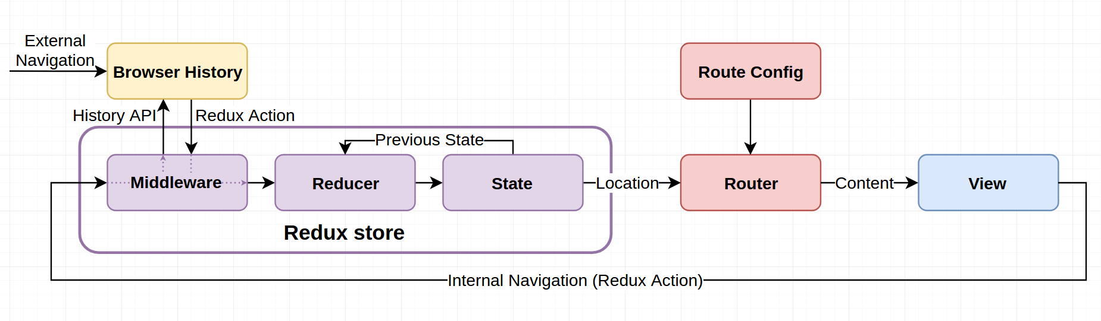
React With Redux
Redux to manage your application state.
React Router to do routing.
But the two libraries don't coordinate. You want to do time travel with your application state, but React Router doesn't navigate between pages when you replay actions. It controls an important part of application state: the URL.
react-router-redux
This library helps you keep that bit of state in sync with your Redux store. We keep a copy of the current location hidden in state. When you rewind your application state with a tool like Redux DevTools, that state change is propagated to React Router so it can adjust the component tree accordingly.
Notes:
An incredibly simple and easy to use router for react redux apps. All that is required is a routes config object to be set, then import the Router component and routerReducer and pass the store and routes to the Router component.
This library helps you keep that bit of state in sync with your Redux store. We keep a copy of the current location hidden in state. When you rewind your application state with a tool like Redux DevTools, that state change is propagated to React Router so it can adjust the component tree accordingly. You can jump around in state, rewinding, replaying, and resetting as much as you'd like, and this library will ensure the two stay in sync at all times.
Install
npm install --save react-router-redux@next
npm install --save history
We have to use the following import
import { Router, Route, browserHistory } from 'react-router' import { syncHistoryWithStore, routerReducer } from 'react-router-redux'
Set Up routes
=========
import React from 'react'
import Home from './components/Home'
import About from './components/About'
const MyRoutes = [
{ path: '/', component: <Home /> },
{ path: '/about', component: <About /> }
];
Basic setup of react route redux:
======================
import React from 'react'
import { Provider } from 'react-redux'
import ReactDOM from 'react-dom'
import { createStore, combineReducers } from 'redux'
import counter from './reducers'
import { Router, routerReducer } from '../../../'
import MyRoutes from './routes'
const store = createStore(
combineReducers({
counter,
router: routerReducer
}))
const rootEl = document.getElementById('root')
const render = () => ReactDOM.render(
<Provider store={store}>
<Router store={store} routes={MyRoutes} />
</Provider>,
rootEl
)
render()
store.subscribe(render)
export default MyRoutes;

Slide 20
Demo
React Redux & Redux Dev Tools
react-create-redux-router
react-create-route-redux
Notes:
Add instructor notes here.

Slide 21
Summary
By Now you would have been clear with
React Router, redux, middleware and redux dev tools
Notes:
Add the notes here.
Add instructor notes here.

Slide 22
review
How will you import route and router from ‘react-router’ library
1. import {Router, Route} from 'react-router';
2. import Router, Route from 'react-router';
3. import Router, Route from react-router;
4. import all from 'react-router';
_____________component to create a route available at a specific location available at a url.
1. <Route/>
2. <Router/>
3. <BrowserRouter />
4. <Rotuing/>
Which provides a third-party extension point between dispatching an action and handing the action off to the reducer.
1. Middleware
2. Redux
3. flux
4. Gulp

